Slide 1
Inter service Communication patterns
Shakti Singh Tanwar
Technical Evangelist
SK JOB SEEDERS PVT LTD

Slide 2
Introduction
A microservices-based application is a distributed system running on multiple machines.
Each service instance is typically a process.

Slide 3
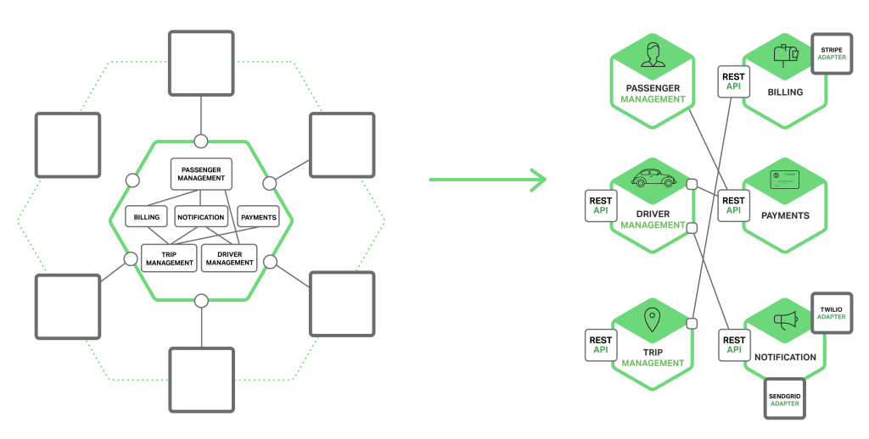
Introduction

Slide 4
Interaction Styles
One-to-one
Each client request is processed by exactly one service instance.
One-to-many
Each request is processed by multiple service instances.
Synchronous
The client expects a timely response from the service and might even block while it waits.
Asynchronous
The client doesn’t block while waiting for a response, and the response, if any, isn’t necessarily sent immediately.

Slide 5
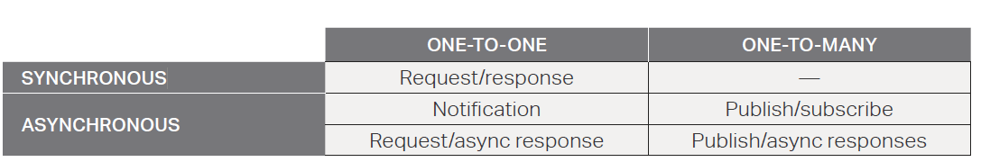
Interaction Styles

Slide 6
one-to-one interactions
Request/response –
A client makes a request to a service and waits for a response.
The client expects the response to arrive in a timely fashion. In a thread-based application, the thread that makes the request might even block while waiting.
Notification (a.k.a. a one-way request) –
A client sends a request to a service but no reply is expected or sent.
Request/async response –
A client sends a request to a service, which replies asynchronously.
The client does not block while waiting and is designed with the assumption that the response might not arrive for a while.

Slide 7
one-to-many interactions
Publish/subscribe – A client publishes a notification message, which is consumed by zero or more interested services.
Publish/async responses – A client publishes a request message, and then waits a certain amount of time for responses from interested services.

Slide 8
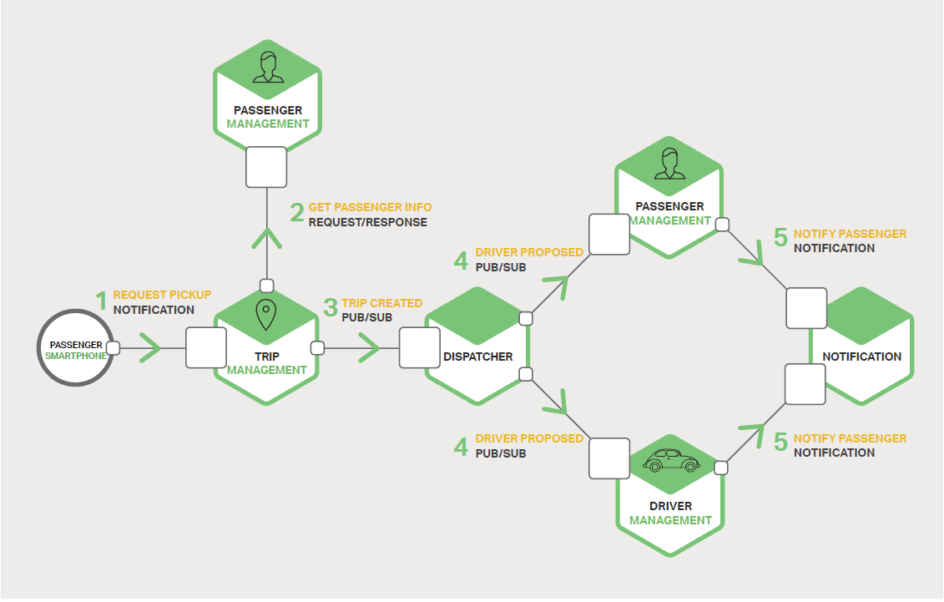
Example

Slide 9
Defining APIs
A service’s API is a contract between the service and its clients.
Interface definition language (IDL)
Swagger
Api First Design
Nature of the API definition depends on IPC mechanism used.
If you are using messaging, the API consists of the message channels and the message types.
If you are using HTTP, the API consists of the URLs and the request and response formats.

Slide 10
Evolving APIs
Incrementally deploy new versions of a service
Follow robustness principle.
Clients that use an older API should continue to work with the new version of the service.
The service provides default values for the missing request attributes and the clients ignore any extra response attributes
Comes versioning

Slide 11
Handling Partial Failure
The strategies for dealing with partial failures include:
Network timeouts
Never block indefinitely and always use timeouts when waiting for a response.
Using timeouts ensures that resources are never tied up indefinitely.
Limiting the number of outstanding requests –
Impose an upper bound on the number of outstanding requests that a client can have with a particular service.
If the limit has been reached, it is probably pointless to make additional requests, and those attempts need to fail immediately.

Slide 12
Handling Partial Failure
The strategies for dealing with partial failures include:
Circuit breaker pattern
Track the number of successful and failed requests. If the error rate exceeds a configured threshold, trip the circuit breaker so that further attempts fail immediately.
If a large number of requests are failing, that suggests the service is unavailable and that sending requests is pointless. After a timeout period, the client should try again and, if successful, close the circuit breaker.
Provide fallbacks
Perform fallback logic when a request fails. For example, return cached data or a default value, such as an empty set of recommendations.

Slide 13
IPC Technologies
Synchronous request/response-based communication mechanisms such as HTTP-based REST or Thrift.
Asynchronous, message-based communication mechanisms such as AMQP or STOMP.

Slide 14
Message formats
Human readable, text-based formats such as JSON or XML.
Alternatively, they can use a binary format (which is more efficient) such as Avro or Protocol Buffers

Slide 15
Asynchronous, Message-Based Communication
A client makes a request to a service by sending it a message.
If the service is expected to reply, it does so by sending a separate message back to the client.
Since the communication is asynchronous, the client does not block waiting for a reply.
Instead, the client is written assuming that the reply will not be received immediately
A message consists of
headers (metadata such as the sender)
Message body.
Messages are exchanged over channels.
Any number of producers can send messages to a channel.
Any number of consumers can receive messages from a channel.

Slide 16
Asynchronous, Message-Based Communication
Channel Types
A point‑to‑point channel
Delivers a message to exactly one of the consumers that are reading from the channel.
A publish‑subscribe channel delivers each message to all of the attached consumers.
Example RabbitMQ, Apache Kafka, Apache ActiveMQ, and NSQ

Slide 17
Asynchronous, Message-Based Communication
Advantages
Decouples the client from the service –
A client makes a request simply by sending a message to the appropriate channel. The client is completely unaware of the service instances.
It does not need to use a discovery mechanism to determine the location of a service instance.
Message buffering
With a synchronous request/response protocol, such as HTTP, both the client and service must be available for the duration of the exchange.
In contrast, a message broker queues up the messages written to a channel until the consumer can process them.
This means, for example, that an online store can accept orders from customers even when the order fulfillment system is slow or unavailable.
The order messages simply queue up.

Slide 18
Asynchronous, Message-Based Communication
Advantages
Flexible client-service interactions
Messaging supports all of the interaction styles described earlier.
Explicit inter-process communication
RPC-based mechanisms attempt to make invoking a remote service look the same as calling a local service.
Messaging makes these differences very explicit so developers are not lulled into a false sense of security.

Slide 19
Asynchronous, Message-Based Communication
Disadvantages:
Additional operational complexity
The messaging system is yet another system component that must be installed, configured, and operated.
It’s essential that the message broker be highly available, otherwise system reliability is impacted.
Complexity of implementing request/response-based interaction
Request/response style interaction requires some work to implement.
Each request message must contain a reply channel identifier and a correlation identifier.
The service writes a response message containing the correlation ID to the reply channel.
The client uses the correlation ID to match the response with the request.
It is often easier to use an IPC mechanism that directly supports request/response.

Slide 20
Synchronous, Request/Response IPC
Rest
Thrift

Slide 21
Synchronous, Request/Response IPC
Advantages
HTTP is simple and familiar.
You can test an HTTP API from within a browser using an extension such as Postman, or from the command line using curl (assuming JSON or some other text format is used).
It directly supports request/response-style communication.
HTTP is, of course, firewall-friendly.
It doesn’t require an intermediate broker, which simplifies the system’s architecture
Disadvantages
HTTP only directly supports the request/response style of interaction. You can use
HTTP for notifications but the server must always send an HTTP response.
Because the client and service communicate directly (without an intermediary to buffer messages), they must both be running for the duration of the exchange.
The client must know the location

Slide 22
Thank You

